Slide 1
Constraint Satisfaction Problems

Slide 2
Outline
What is a CSP
1.Backtracking for CSP
Intelligent Backtracking
2.Forward Checking
3.Constraint Propagation
4. Local search for CSPs(Min Conflicts)

Slide 3
Constraint Satisfaction Problems
What is a CSP?
  Finite set of variables V₁, V₂, …, V_{n}
    Nonempty domain of possible values for each variable
    D_{V1}, D_{V2}, … D_{Vn}
  Finite set of constraints C₁, C₂, …, C_{m}
    Each constraint C_{i} limits the values that variables can take,
      e.g., V₁ ≠ V₂
A state is defined as an assignment of values to some or all variables.
Consistent assignment
  assignment does not violate the constraints
CSP benefits
  Standard representation pattern
  Generic goal and successor functions
  Generic heuristics (no domain specific expertise).

Slide 4
CSPs (continued)
An assignment is complete when every variable is mentioned.
A solution to a CSP is a complete assignment that satisfies all constraints.
Some CSPs require a solution that maximizes an objective function.
Examples of Applications:
  Scheduling the time of observations on the Hubble Space Telescope
  Airline schedules
  Cryptography
  Computer vision -> image interpretation

Slide 5
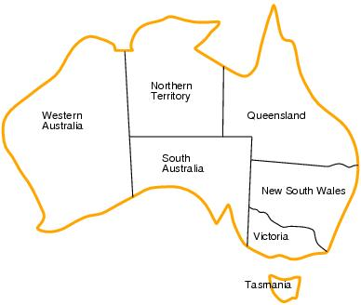
CSP example: map coloring
Variables: WA, NT, Q, NSW, V, SA, T
Domains: D_{i}={red,green,blue}
Constraints:adjacent regions must have different colors.
    E.g. WA ≠ NT

Slide 6
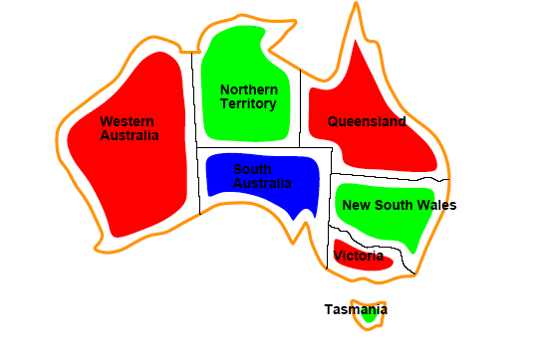
CSP example: map coloring
Solutions are assignments satisfying all constraints, e.g.
{WA=red,NT=green,Q=red,NSW=green,V=red,SA=blue,T=green}

Slide 7
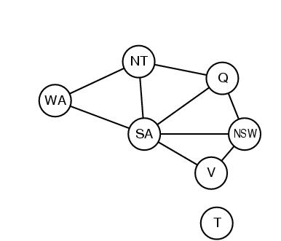
Constraint graphs
Constraint graph:
  nodes are variables
  arcs are binary constraints
Graph can be used to simplify search
e.g. Tasmania is an independent subproblem
(will return to graph structure later)

Slide 8
Varieties of CSPs
Discrete variables
  Finite domains; size d ⇒O(d^{n}) complete assignments.
    E.g. Boolean CSPs: Boolean satisfiability (NP-complete).
  Infinite domains (integers, strings, etc.)
    E.g. job scheduling, variables are start/end days for each job
    Need a constraint language e.g StartJob₁ +5 ≤ StartJob₃.
Continuous variables
  e.g. building an airline schedule or class schedule.
  Linear constraints solvable in polynomial time by LP methods.

Slide 9
Varieties of constraints
Unary constraints involve a single variable.
  e.g. SA ≠ green
Binary constraints involve pairs of variables.
  e.g. SA ≠ WA
Higher-order constraints involve 3 or more variables.
  Professors A, B,and C cannot be on a committee together
  Can always be represented by multiple binary constraints
Preference (soft constraints)
  e.g. red is better than green often can be represented by a cost for each variable assignment
  combination of optimization with CSPs

Slide 10
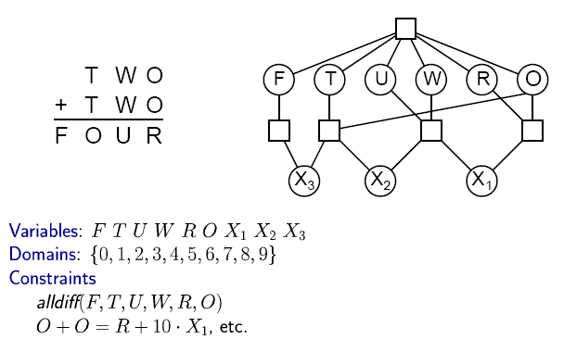

CSP Example: Cryptharithmetic puzzle

Slide 11
CSP Example: Cryptharithmetic puzzle

Slide 12
CSP as a standard search problem
A CSP can easily be expressed as a standard search problem.
Incremental formulation
  Initial State: the empty assignment {}
  Successor function: Assign a value to any unassigned variable provided that it does not violate a constraint
  Goal test: the current assignment is complete
    (by construction its consistent)
  Path cost: constant cost for every step (not really relevant)
Can also use complete-state formulation
  Local search techniques (Chapter 4) tend to work well

Slide 13
Backtracking search
Similar to Depth-first search
Chooses values for one variable at a time and backtracks when a variable has no legal values left to assign.
Uninformed algorithm
  No good general performance (see table p. 143)

Slide 14
Backtracking search
function BACKTRACKING-SEARCH(csp) return a solution or failure
return RECURSIVE-BACKTRACKING({} , csp)
function RECURSIVE-BACKTRACKING(assignment, csp) return a solution or failure
if assignment is complete then return assignment
var ← SELECT-UNASSIGNED-VARIABLE(VARIABLES[csp],assignment,csp)
for each value in ORDER-DOMAIN-VALUES(var, assignment, csp) do
if value is consistent with assignment according to CONSTRAINTS[csp] then
add {var=value} to assignment
result ← RRECURSIVE-BACTRACKING(assignment, csp)
if result ≠ failure then return result
remove {var=value} from assignment
return failure

Slide 15
Backtracking example

Slide 16
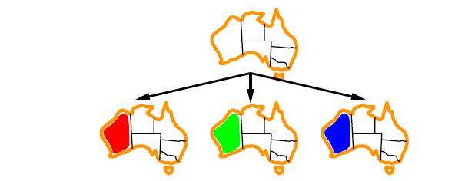
Backtracking example

Slide 17
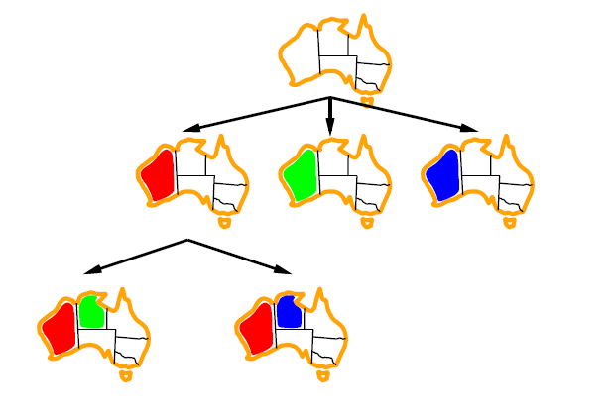
Backtracking example

Slide 18
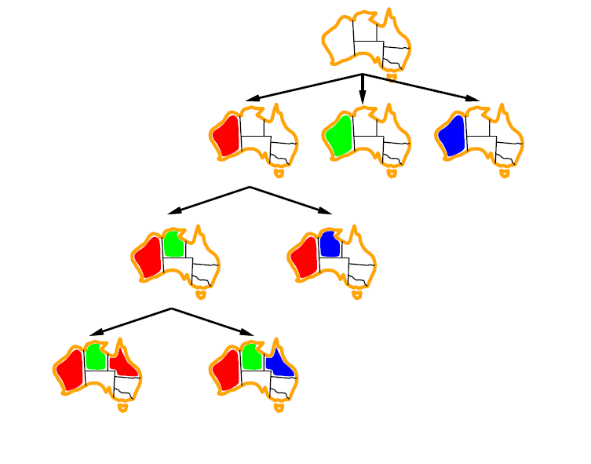
Backtracking example

Slide 19

Minimum remaining values (MRV)
var ← SELECT-UNASSIGNED-VARIABLE(VARIABLES[csp],assignment,csp)
A.k.a. most constrained variable heuristic
Heuristic Rule: choose variable with the fewest legal moves
  e.g., will immediately detect failure if X has no legal values

Slide 20

Degree heuristic for the initial variable
Heuristic Rule: select variable that is involved in the largest number of constraints on other unassigned variables.
Degree heuristic can be useful as a tie breaker.
In what order should a variable’s values be tried?

Slide 21
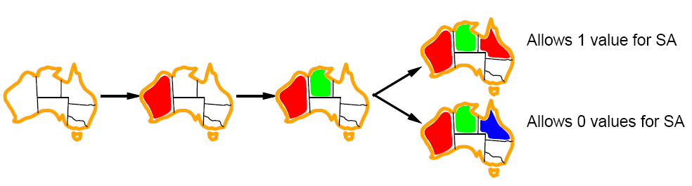
Least constraining value for value-ordering
Least constraining value heuristic
Heuristic Rule: given a variable choose the least constraining value
  leaves the maximum flexibility for subsequent variable assignments

Slide 22
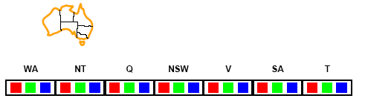
Forward checking
Can we detect inevitable failure early?
  And avoid it later?
Forward checking idea: keep track of remaining legal values for unassigned variables.
Terminate search when any variable has no legal values.

Slide 23
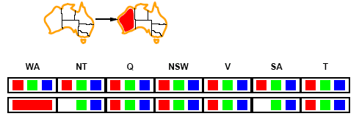
Forward checking
Assign {WA=red}
Effects on other variables connected by constraints to WA
  NT can no longer be red
  SA can no longer be red

Slide 24
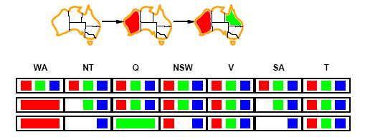
Forward checking
Assign {Q=green}
Effects on other variables connected by constraints with WA
  NT can no longer be green
  NSW can no longer be green
  SA can no longer be green
MRV heuristic would automatically select NT or SA next

Slide 25
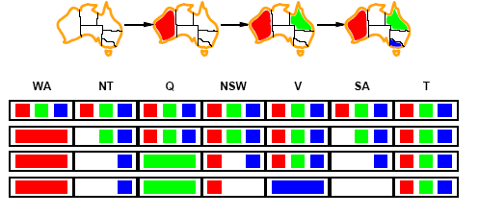
Forward checking
If V is assigned blue
Effects on other variables connected by constraints with WA
  NSW can no longer be blue
  SA is empty
FC has detected that partial assignment is inconsistent with the constraints and backtracking can occur.

Slide 26
Example: 4-Queens Problem
X1
{1,2,3,4}
X2
{1,2,3,4}
1
2
3
4
1
2
3
4
X3
{1,2,3,4}
X4
{1,2,3,4}

Slide 27
Example: 4-Queens Problem
X1
{1,2,3,4}
X2
{1,2,3,4}
1
2
3
4
1
2
3
4
X3
{1,2,3,4}
X4
{1,2,3,4}

Slide 28
Example: 4-Queens Problem
X1
{1,2,3,4}
X2
{ , ,3,4}
1
2
3
4
1
2
3
4
X3
{ ,2, ,4}
X4
{ ,2,3, }

Slide 29
Example: 4-Queens Problem
X1
{1,2,3,4}
X2
{ , ,3,4}
1
2
3
4
1
2
3
4
X3
{ ,2, ,4}
X4
{ ,2,3, }

Slide 30
Example: 4-Queens Problem
X1
{1,2,3,4}
X2
{ , ,3,4}
1
2
3
4
1
2
3
4
X3
{ , , , }
X4
{ , ,3, }

Slide 31
Example: 4-Queens Problem
X1
{1,2,3,4}
X2
{ , , ,4}
1
2
3
4
1
2
3
4
X3
{ ,2, ,4}
X4
{ ,2,3, }

Slide 32
Example: 4-Queens Problem
X1
{1,2,3,4}
X2
{ , , ,4}
1
2
3
4
1
2
3
4
X3
{ ,2, ,4}
X4
{ ,2,3, }

Slide 33
Example: 4-Queens Problem
X1
{1,2,3,4}
X2
{ , , ,4}
1
2
3
4
1
2
3
4
X3
{ ,2, , }
X4
{ , ,3, }

Slide 34
Example: 4-Queens Problem
X1
{1,2,3,4}
X2
{ , , ,4}
1
2
3
4
1
2
3
4
X3
{ ,2, , }
X4
{ , ,3, }

Slide 35
Example: 4-Queens Problem
X1
{1,2,3,4}
X2
{ , ,3,4}
1
2
3
4
1
2
3
4
X3
{ ,2, , }
X4
{ , , , }

Slide 36
Constraint propagation
Solving CSPs with combination of heuristics plus forward checking is more efficient than either approach alone
FC checking does not detect all failures.
  E.g., NT and SA cannot be blue

Slide 37
Constraint propagation
Techniques like CP and FC are in effect eliminating parts of the search space
  Somewhat complementary to search
Constraint propagation goes further than FC by repeatedly enforcing constraints locally
  Needs to be faster than actually searching to be effective
Arc-consistency (AC) is a systematic procedure for constraing propagation

Slide 38
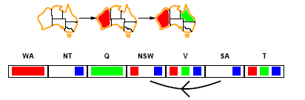
Arc consistency
An Arc X → Y is consistent if
for every value x of X there is some value y consistent with x
(note that this is a directed property)
Consider state of search after WA and Q are assigned:
SA → NSW is consistent if
SA=blue and NSW=red

Slide 39
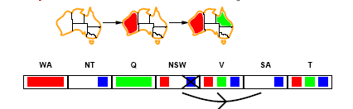
Arc consistency
X → Y is consistent if
for every value x of X there is some value y consistent with x
NSW → SA is consistent if
NSW=red and SA=blue
NSW=blue and SA=???

Slide 40
Arc consistency algorithm (AC-3)
function AC-3(csp) return the CSP, possibly with reduced domains
inputs: csp, a binary csp with variables {X₁, X₂, …, X_{n}}
local variables: queue, a queue of arcs initially the arcs in csp
while queue is not empty do
(X_{i}, X_{j}) ← REMOVE-FIRST(queue)
if REMOVE-INCONSISTENT-VALUES(X_{i}, X_{j}) then
for each X_{k} in NEIGHBORS[X_{i} ] do
add (X_{i}, X_{j}) to queue
function REMOVE-INCONSISTENT-VALUES(X_{i}, X_{j}) return true iff we remove a value
removed ← false
for each x in DOMAIN[X_{i}] do
if no value y in DOMAIN[X_{i}] allows (x,y) to satisfy the constraints between X_{i} and X_{j}
then delete x from DOMAIN[X_{i}]; removed ← true
return removed

Slide 41
Local search for CSPs
Use complete-state representation
  Initial state = all variables assigned values
  Successor states = change 1 (or more) values
For CSPs
  allow states with unsatisfied constraints (unlike backtracking)
  operators reassign variable values
  hill-climbing with n-queens is an example
Variable selection: randomly select any conflicted variable
Value selection: min-conflicts heuristic
  Select new value that results in a minimum number of conflicts with the other variables

Slide 42
Local search for CSP
function MIN-CONFLICTS(csp, max_steps) return solution or failure
inputs: csp, a constraint satisfaction problem
max_steps, the number of steps allowed before giving up
current ← an initial complete assignment for csp
for i = 1 to max_steps do
if current is a solution for csp then return current
var ← a randomly chosen, conflicted variable from VARIABLES[csp]
value ← the value v for var that minimize CONFLICTS(var,v,current,csp)
set var = value in current
return failure

Slide 43
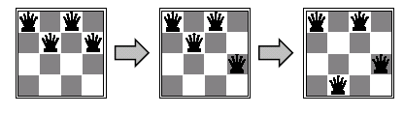
Min-conflicts example 1
h=5
h=3
h=1
Use of min-conflicts heuristic in hill-climbing.

Slide 44
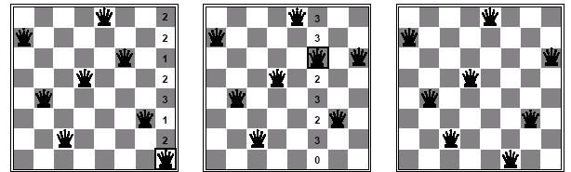
Min-conflicts example 2
A two-step solution for an 8-queens problem using min-conflicts heuristic
At each stage a queen is chosen for reassignment in its column
The algorithm moves the queen to the min-conflict square breaking ties randomly.

Slide 45
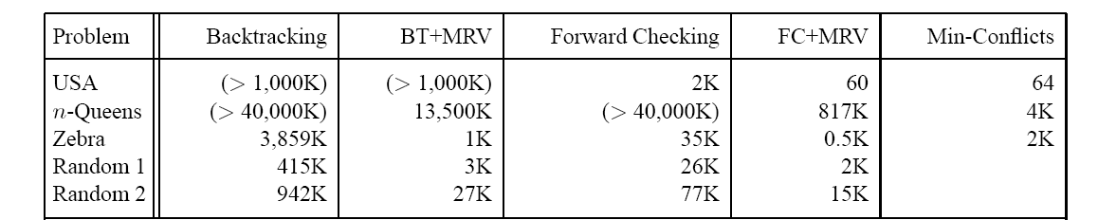
Comparison of CSP algorithms on different problems
Median number of consistency checks over 5 runs to solve problem
Parentheses -> no solution found
USA: 4 coloring
n-queens: n = 2 to 50
Zebra: see exercise 5.13

Slide 46
Advantages of local search
Local search can be particularly useful in an online setting
  Airline schedule example
    E.g., mechanical problems require than 1 plane is taken out of service
    Can locally search for another “close” solution in state-space
    Much better (and faster) in practice than finding an entirely new schedule
The runtime of min-conflicts is roughly independent of problem size.
  Can solve the millions-queen problem in roughly 50 steps.
  Why?
    n-queens is easy for local search because of the relatively high density of solutions in state-space

Slide 47
Summary
CSPs
  special kind of problem: states defined by values of a fixed set of variables, goal test defined by constraints on variable values
Backtracking=depth-first search with one variable assigned per node
Heuristics
  Variable ordering and value selection heuristics help significantly
Constraint propagation does additional work to constrain values and detect inconsistencies
  Works effectively when combined with heuristics
Iterative min-conflicts is often effective in practice.
Graph structure of CSPs determines problem complexity
  e.g., tree structured CSPs can be solved in linear time.

